Slide 1
Computer Communication 18CSS202J
WEEK 4 SESSION 1
By,
A.JOTHIMANI

Slide 2
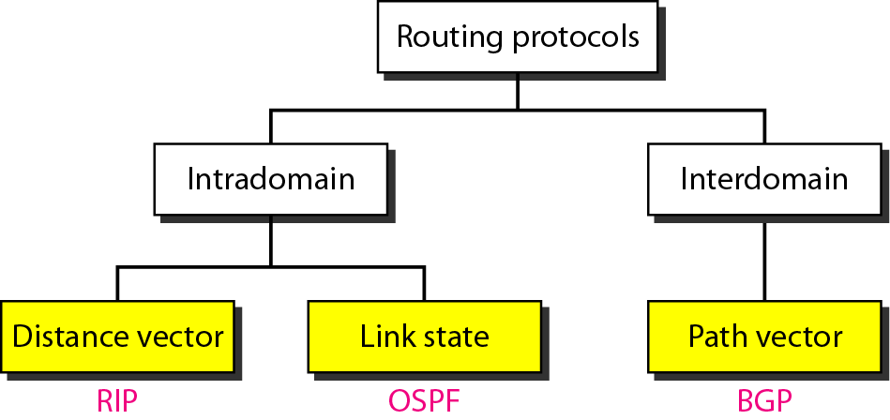
Popular routing protocols

Slide 3
Distance vector routing
The least –cost route between any 2 nodes is the route with minimum distance.
Iterative
Distributed
Asynchronous
Dynamic routing protocol
Three important steps
Initialization
Sharing
Updating

Slide 4
The Meaning of Distance Vector
A router using distance vector routing protocols knows 2 things:
Distance to final destination :-The distance or how far it is to the destination network
Vector, or direction, traffic should be directed :-The direction or interface in which packets should be forwarded

Slide 5
Characteristics of Distance Vector routing protocols:
Periodic updates
Periodic Updates sent at regular intervals (30 seconds for RIP). Even if the topology has not changed in several days,
Neighbors
The router is only aware of the network addresses of its own interfaces and the remote network addresses it can reach through its neighbors.
It has no broader knowledge of the network topology
Broadcast updates
Broadcast Updates are sent to 255.255.255.255.
Some distance vector routing protocols use multicast addresses instead of broadcast addresses.
Entire routing table is included with routing update
Entire Routing Table Updates are sent, with some exceptions to be discussed later, periodically to all neighbors.
Neighbors receiving these updates must process the entire update to find pertinent information and discard the rest. Some distance vector routing protocols like EIGRP do not send periodic routing table updates.

Slide 6
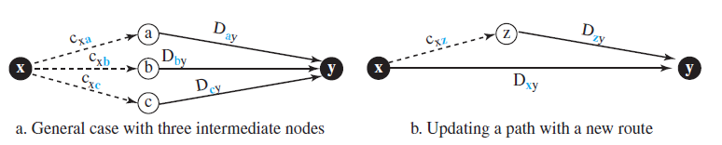
Bellman-Ford Equation
The heart of distance-vector routing is the famous Bellman-Ford equation.
This equation is used to find the least cost (shortest distance) between a source node, x, and a destination node, y, through some intermediary node (a, b, c, . . .) when the costs between the source and the intermediary nodes and the least costs between the intermediary nodes and the destination are given.
Dij is the shortest distance and cij is the cost between nodes i and j.
Dxy = min{(cxa + Day), (cxb + Dby), (cxc + Dcy), …}
In distance-vector routing, normally we want to update an existing least cost with a least cost through an intermediary node, such as z, if the latter is shorter.

Slide 7
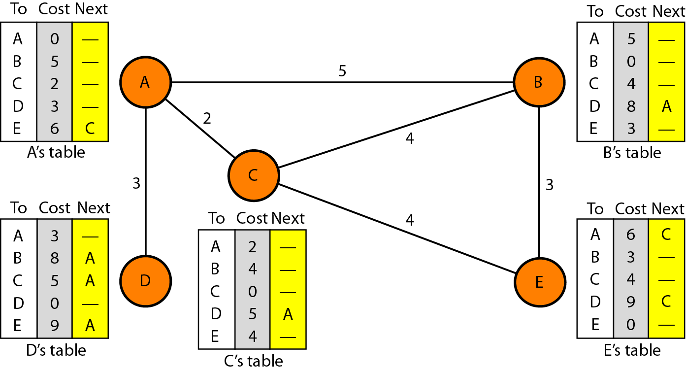
Figure Distance vector routing tables

Slide 8
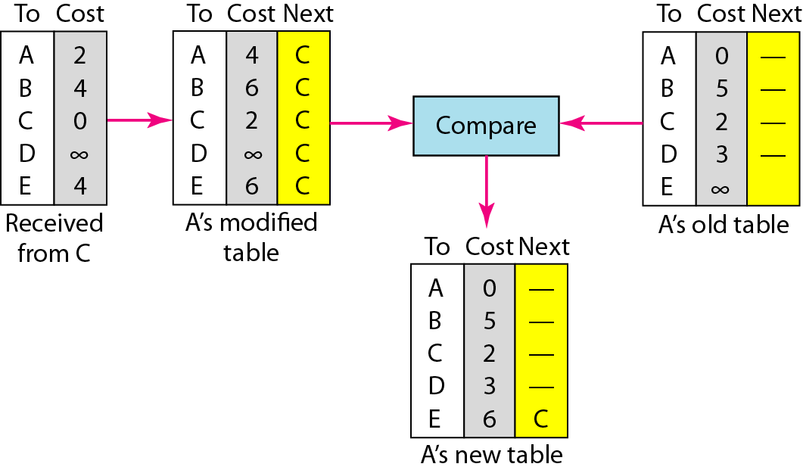
Figure Updating in distance vector routing

Slide 9
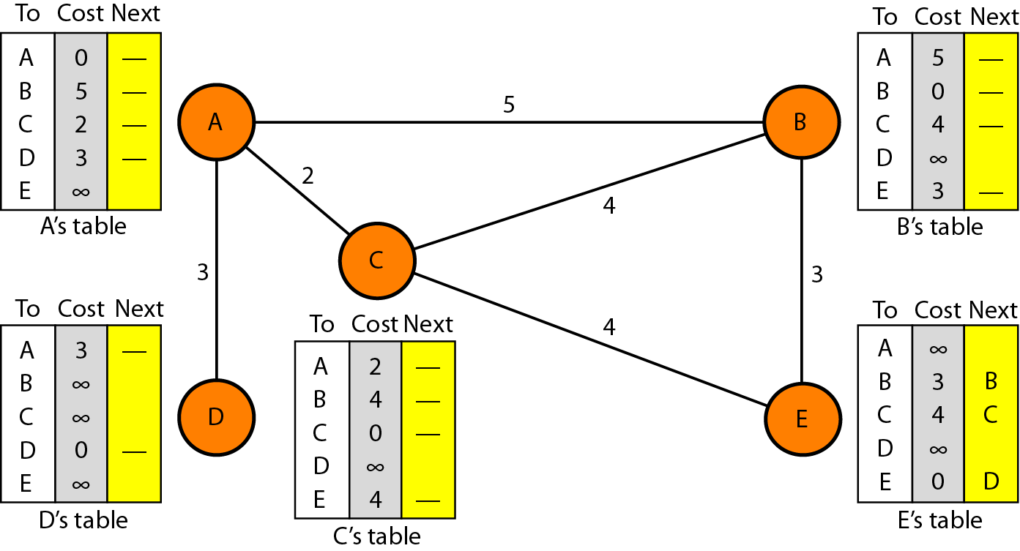
Figure Initialization of tables in distance vector routing

Slide 10
Initialization
a)The table in figure are stable.
b) Each node knows how to reach any other node and their cost.
c) At the beginning, each node know the cost of itself and its immediate neighbor.[those node directly connected to it.]
d)Assume that each node send a message to the immediate neighbors and find the distance between itself and these neighbors.
e) The distance of any entry that is not a neighbor is marked as infinite(unreachable).

Slide 11
Sharing
In distance vector routing, each node shares its routing table with its immediate neighbors periodically and when there is a change.
Updating
The receiving node needs to add the cost between itself and sending node to each value in the 2nd column.
The receiving node needs to add the name of the sending node to each row as the 3rd column.
The receiving node needs to compare each row of its old table with the corresponding row of the modified version of the received table.

Slide 12
Problems in Distance vector
1.COUNT TO INFINITY
A problem with distance-vector routing is that any decrease in cost (good news) propagates quickly, but any increase in cost (bad news) will propagate slowly.
For a routing protocol to work properly, if a link is broken (cost becomes infinity), every other router should be aware of it immediately, but in distance-vector routing, this takes some time. The problem is referred to as count to infinity. It sometimes takes several updates before the cost for a broken link is recorded as infinity by all routers.

Slide 13
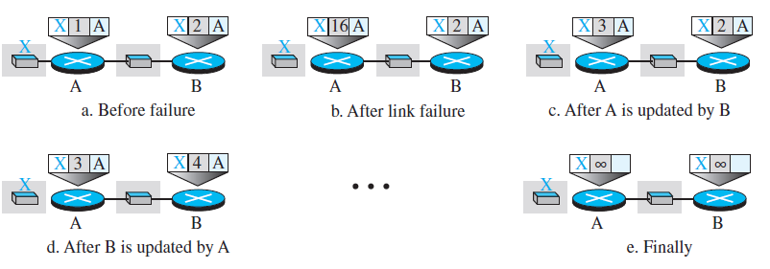
Problems in Distance vector
2.Two Node Instablity
At the beginning, both nodes A and B know how to reach node X.
But suddenly, the link between A and X fails. Node A changes its table. If A can send its table to B immediately, everything is fine.
However, the system becomes unstable if B sends its forwarding table to A before receiving A’s forwarding table. Node A receives the update and, assuming that B has found a way to reach X, immediately updates its forwarding table.
Now A sends its new update to B. Now B thinks that something has been changed around A and updates its forwarding table. The cost of reaching X increases gradually until it reaches infinity.
At this moment, both A and B know that X cannot be reached. However, during this time the system is not stable. Node A thinks that the route to X is via B; node B thinks that the route to X is via A.
If A receives a packet destined for X, the packet goes to B and then comes back to A. Similarly, if B receives a packet destined for X, it goes to A and comes back to B. Packets bounce between A and B, creating a two-node loop problem.

Slide 14
Overcome problems in Distance vector
Split Horizon
One solution to instability is called split horizon.
In this strategy, instead of flooding the table through each interface, each node sends only part of its table through each interface. If, according to its table, node B thinks that the optimum route to reach X is via A, it does not need to advertise this piece of information to A; the information has come from A (A already knows). Taking information from node A, modifying it, and sending it back to node A is what creates the confusion.
In our scenario, node B eliminates the last line of its forwarding table before it sends it to A. In this case, node A keeps the value of infinity as the distance to X. Later, when node A sends its forwarding table to B, node B also corrects its forwarding table. The system becomes stable after the first update: both node A and node B know that X is not reachable.

Slide 15
Overcome problems in Distance vector
Poisson reverse
Using the split-horizon strategy has one drawback. Normally, the corresponding protocol uses a timer, and if there is no news about a route, the node deletes the route from its table.
When node B in the previous scenario eliminates the route to X from its advertisement to A, node A cannot guess whether this is due to the split-horizon strategy (the source of information was A) or because B has not received any news about X recently.
In the poison reverse strategy B can still advertise the value for X, but if the source of information is A, it can replace the distance with infinity as a warning: “Do not use this value; what I know about this route comes from you.”

